Slide 1

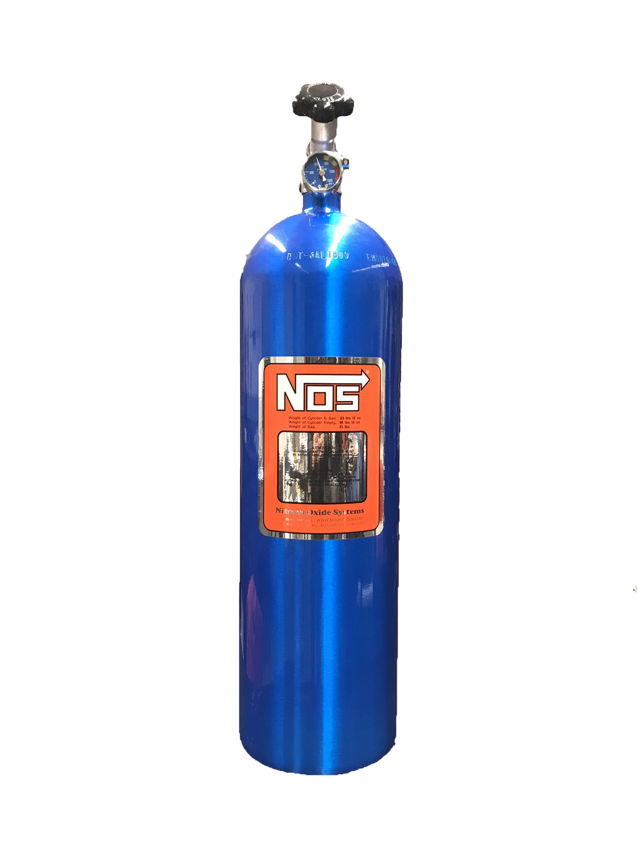



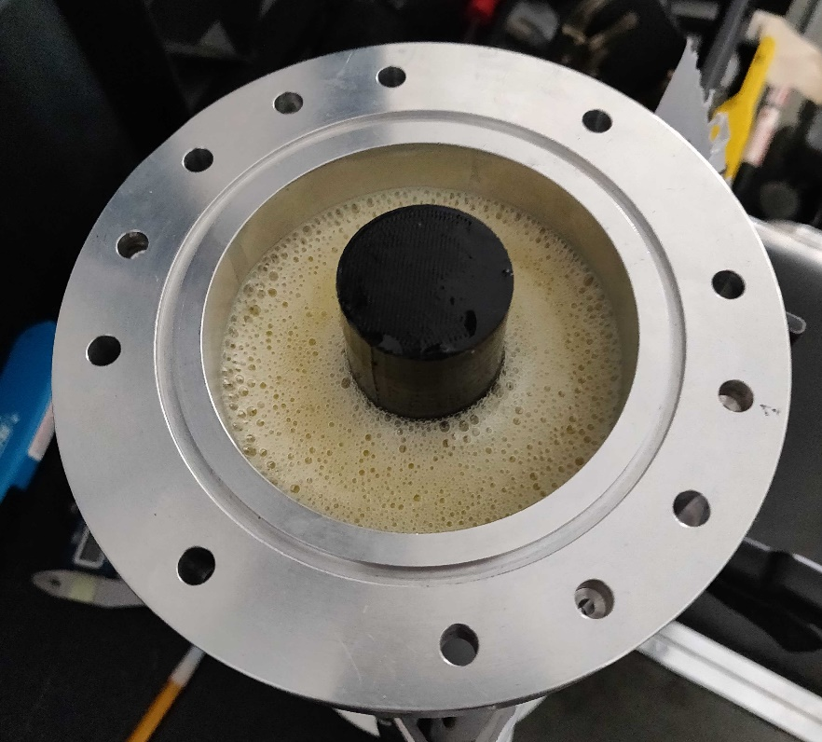


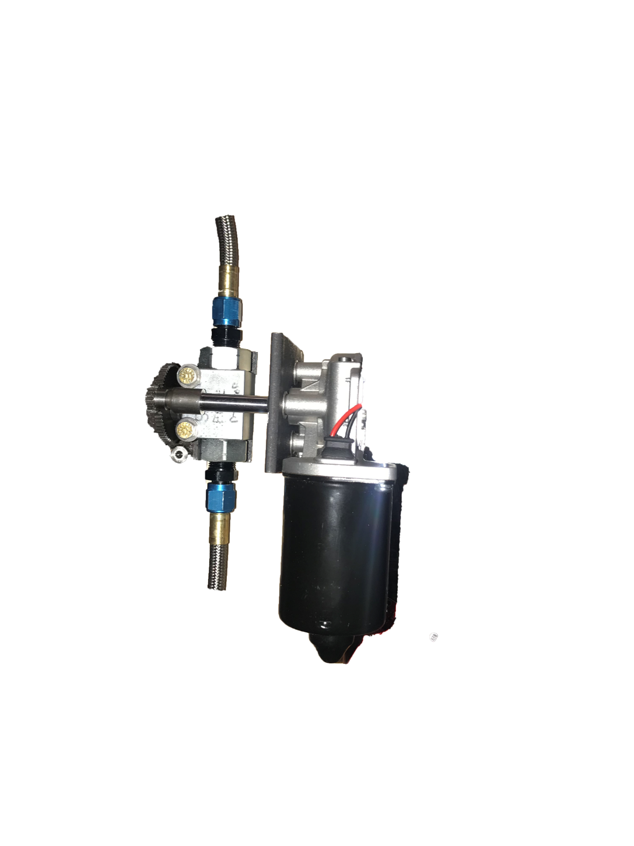
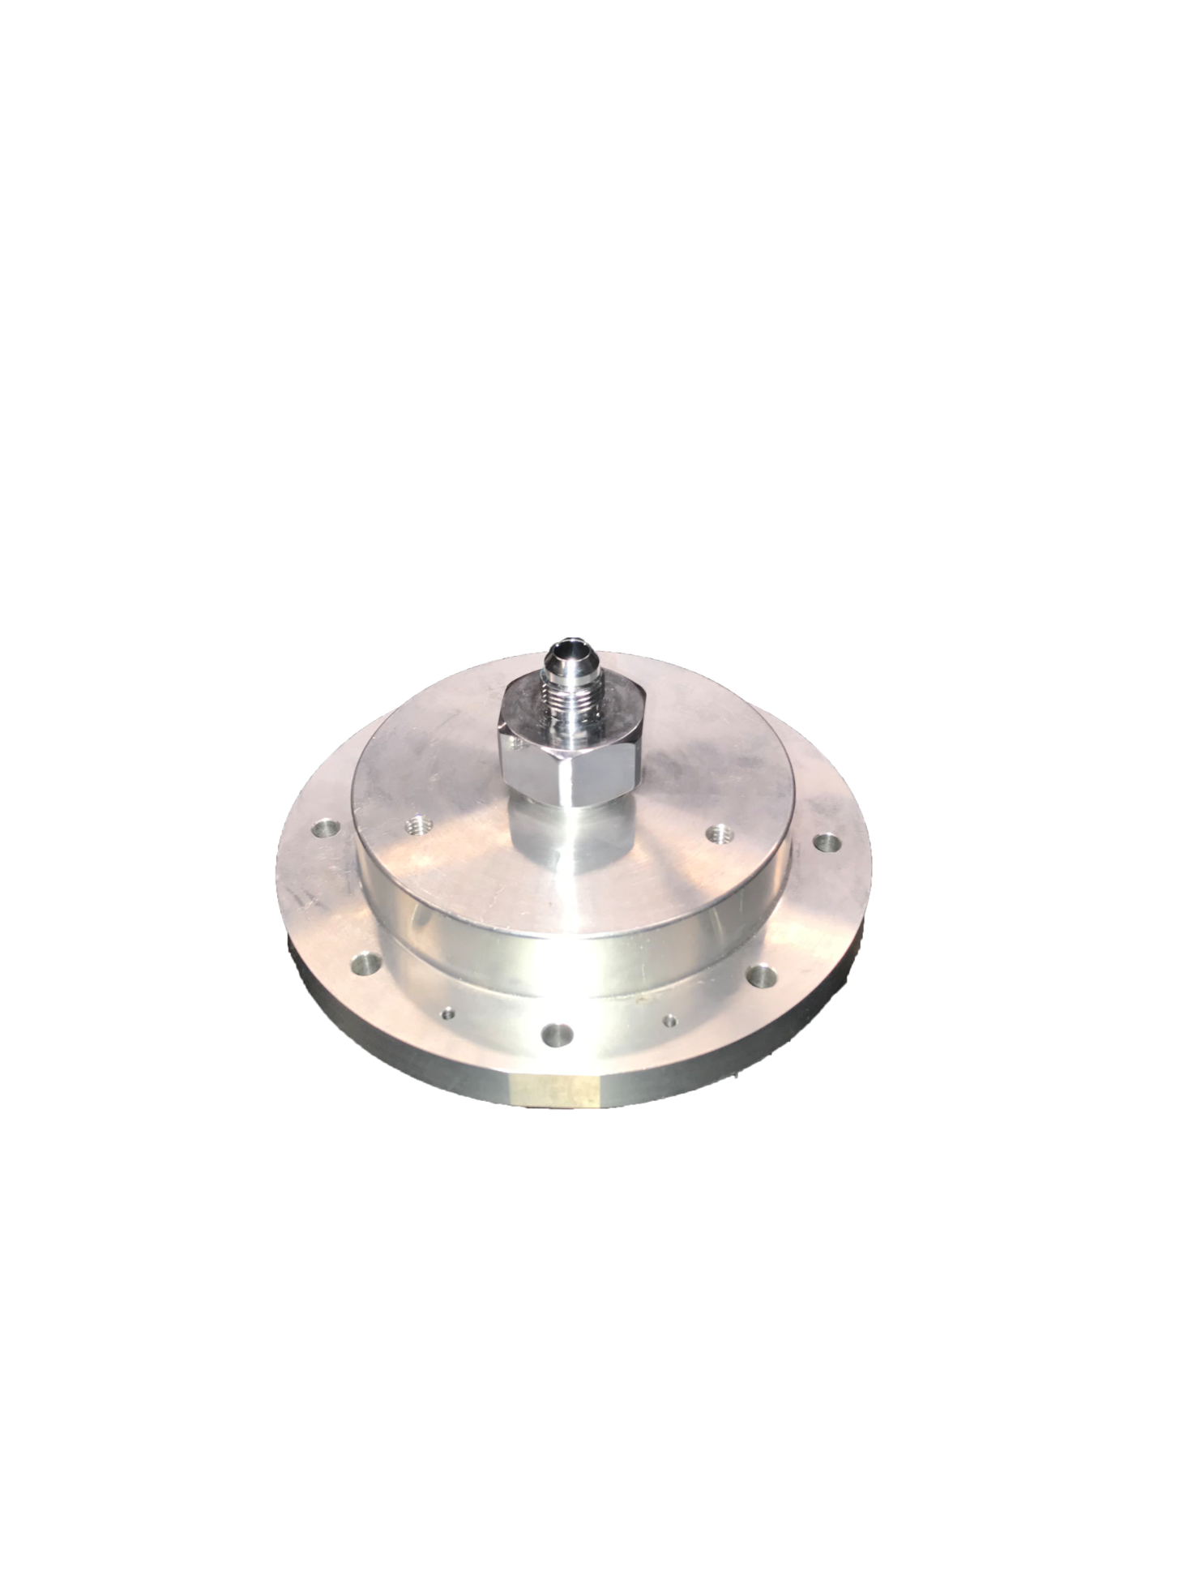
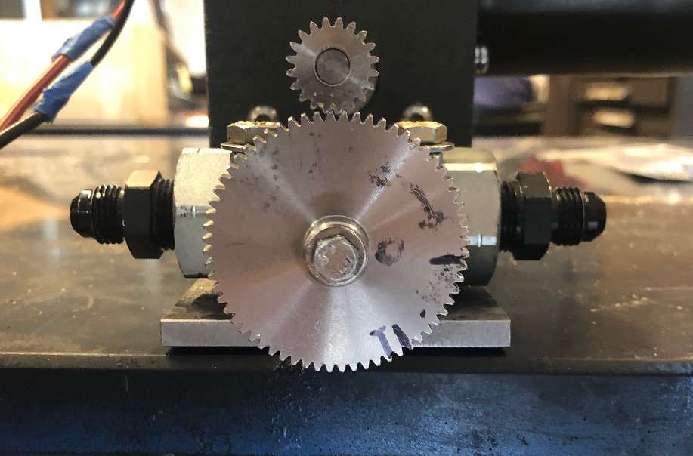
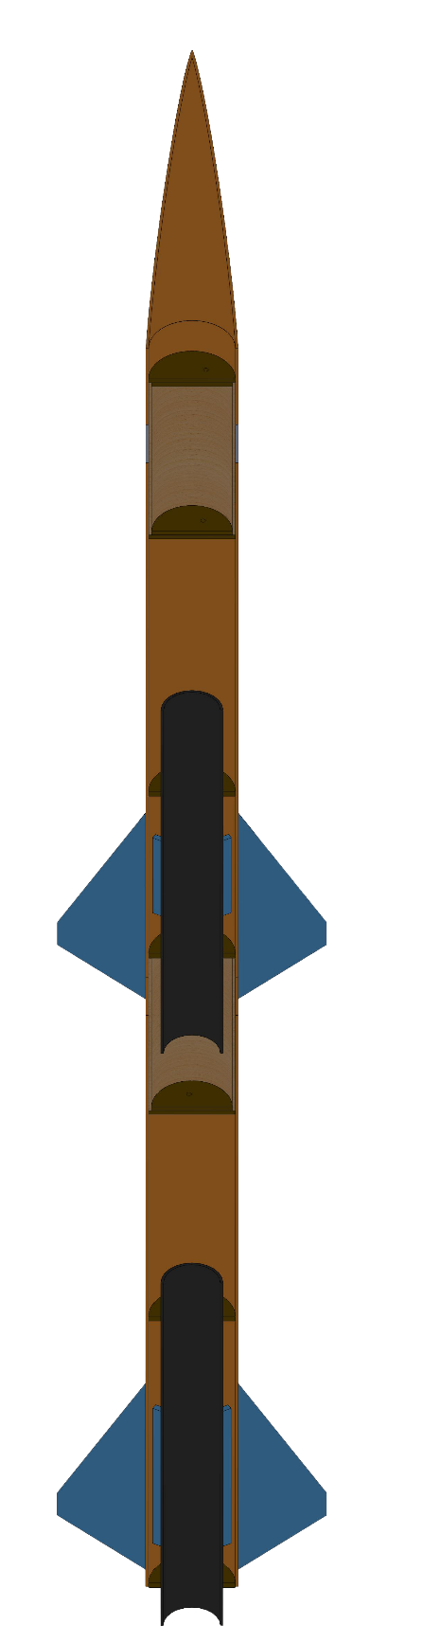
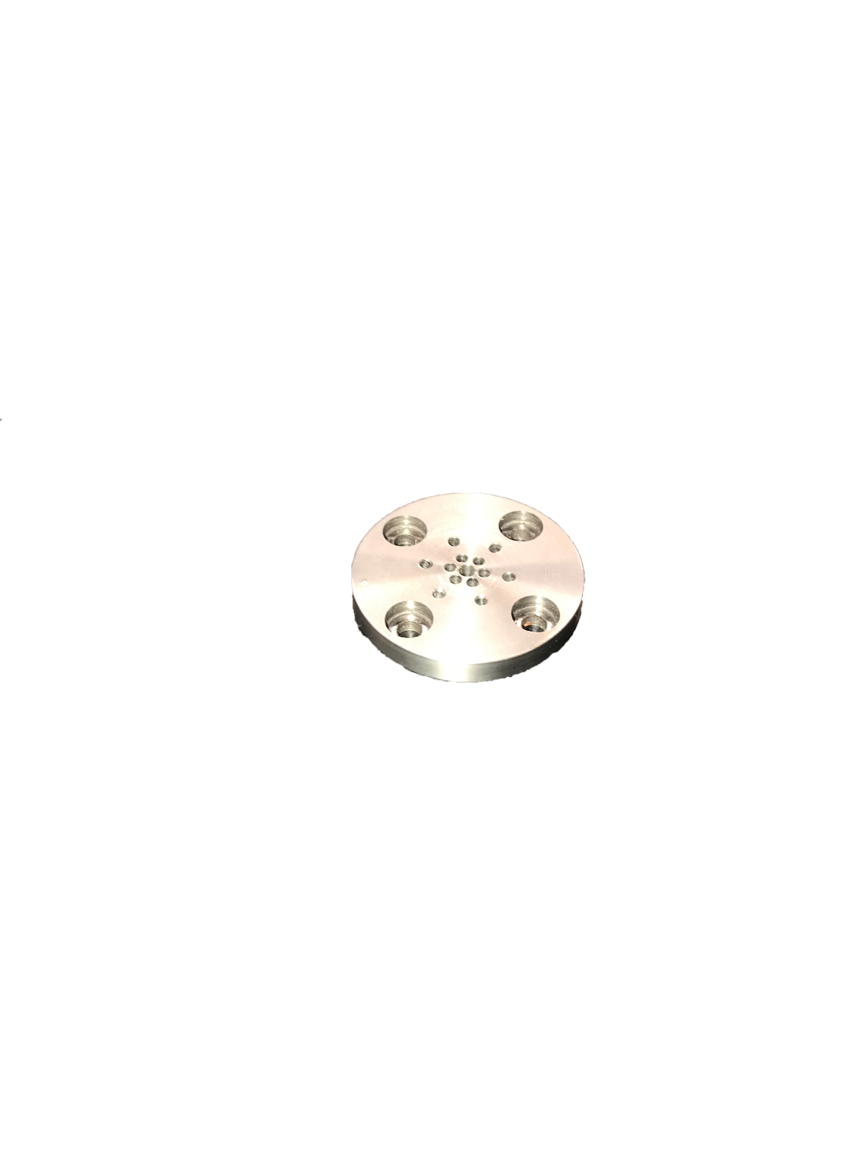


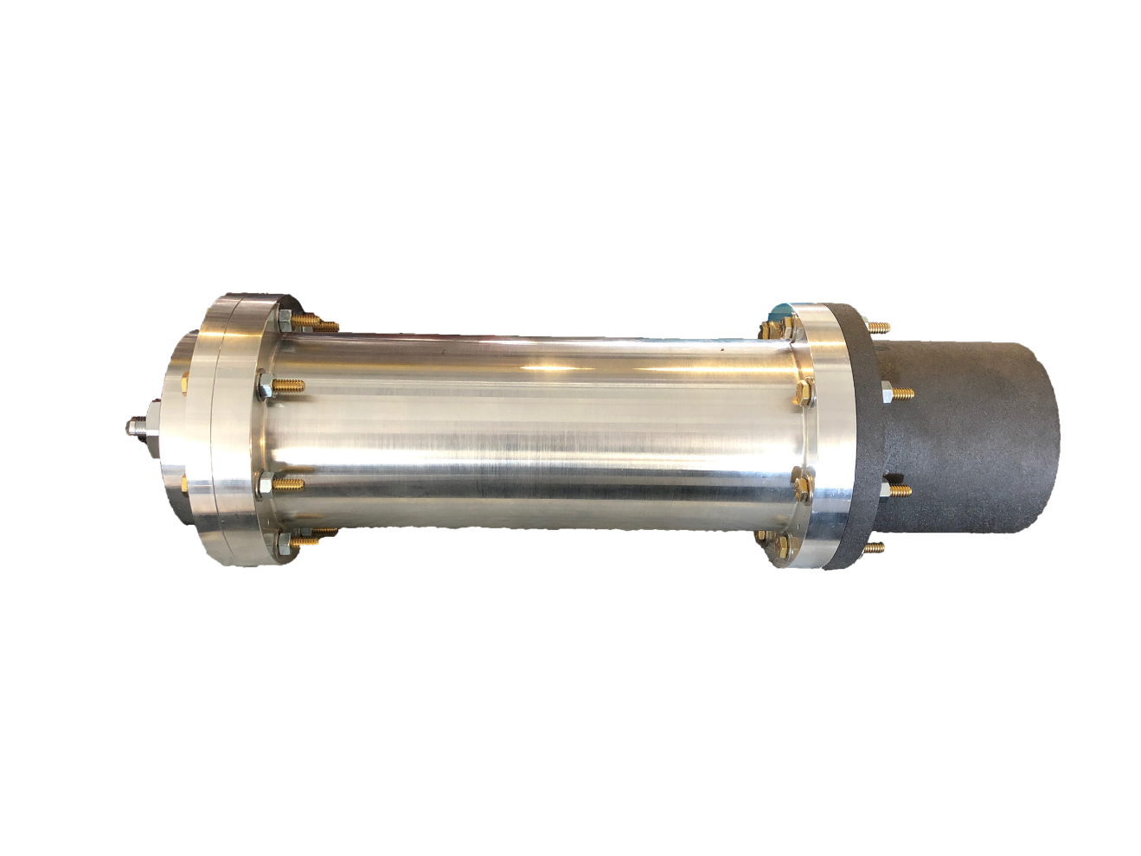
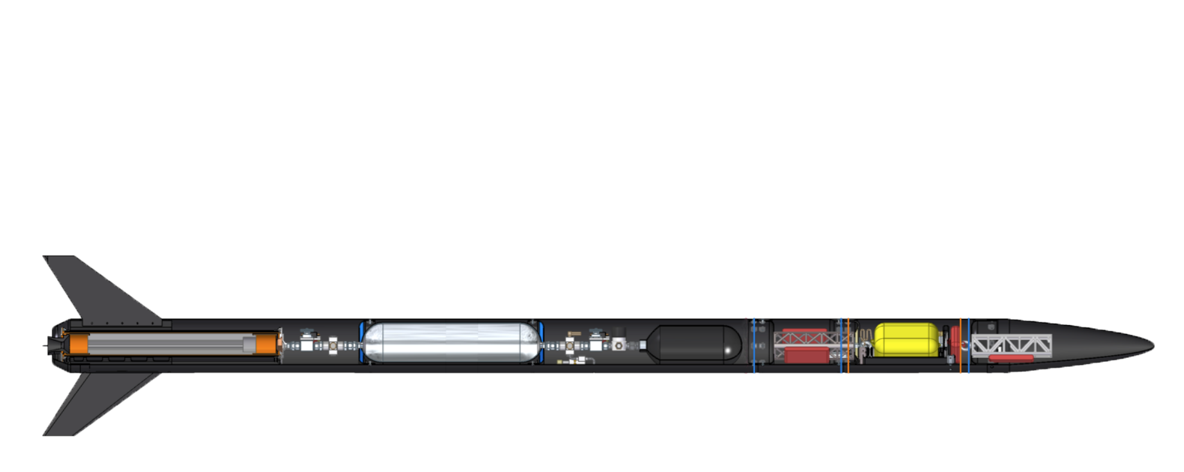
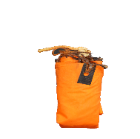
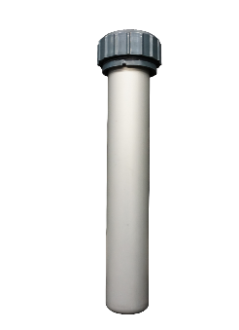
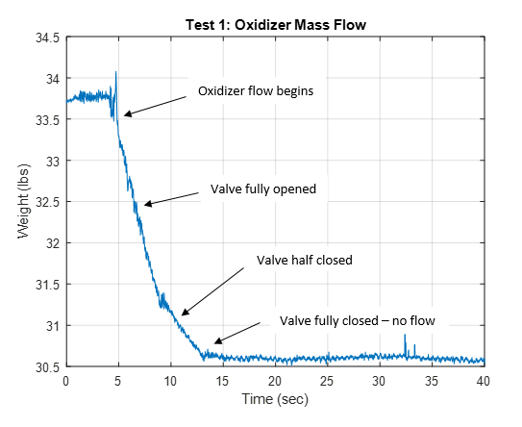


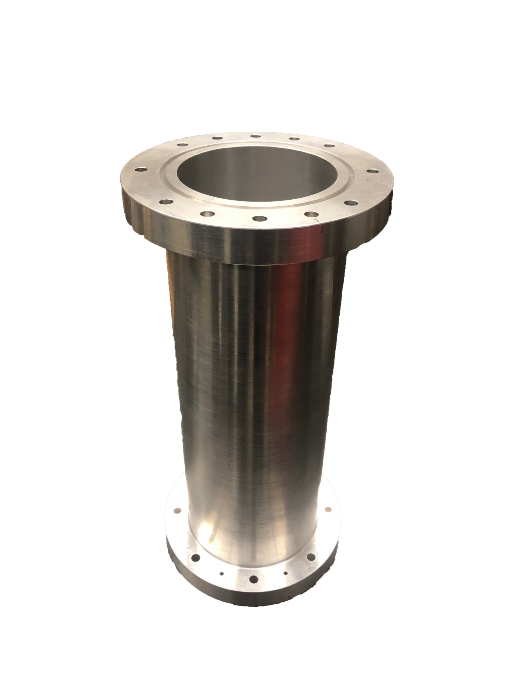
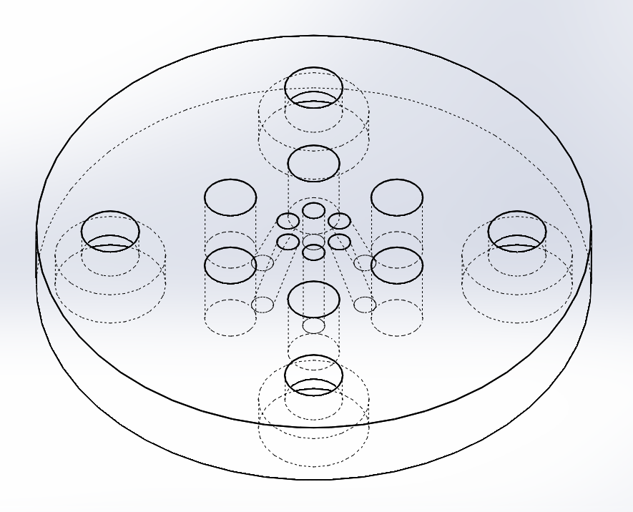

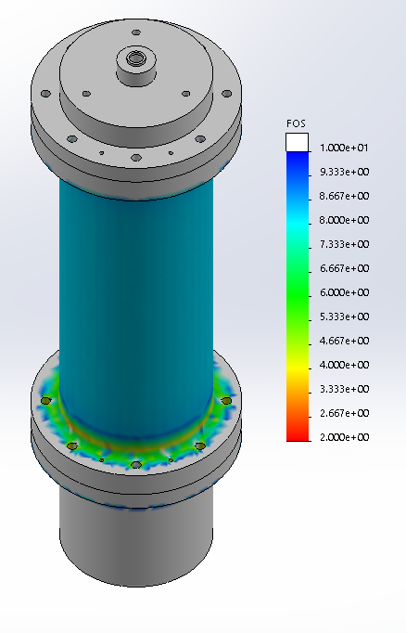
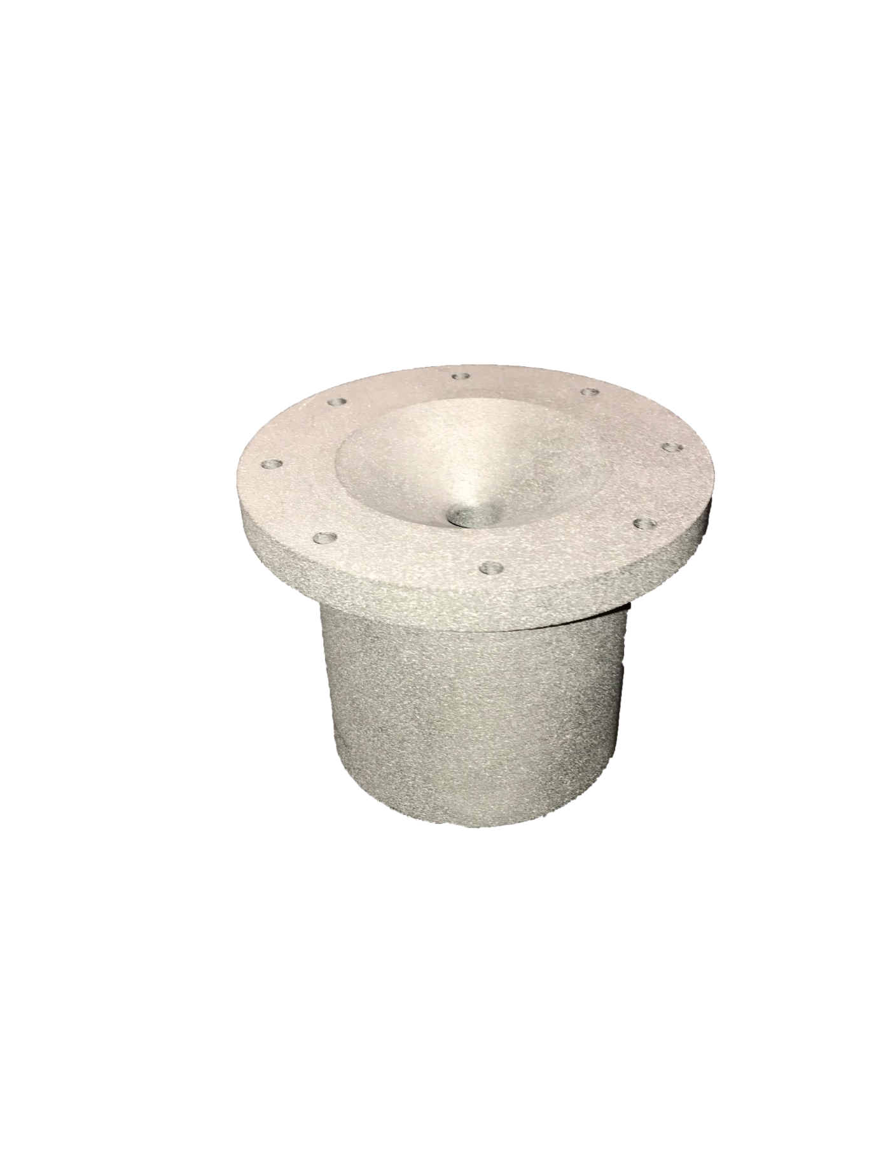
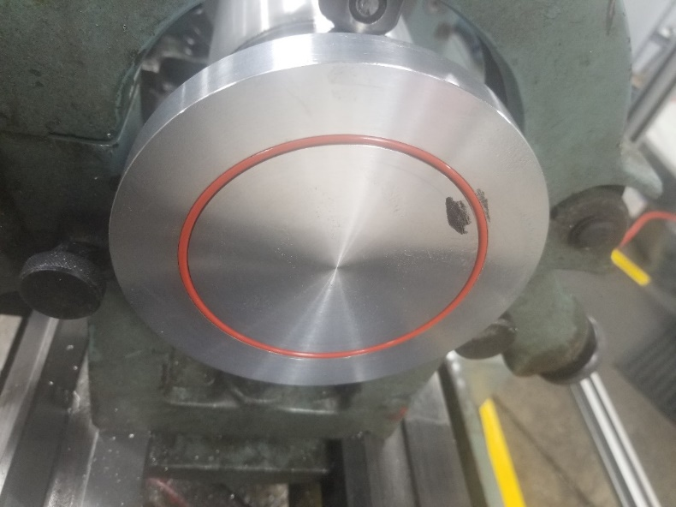
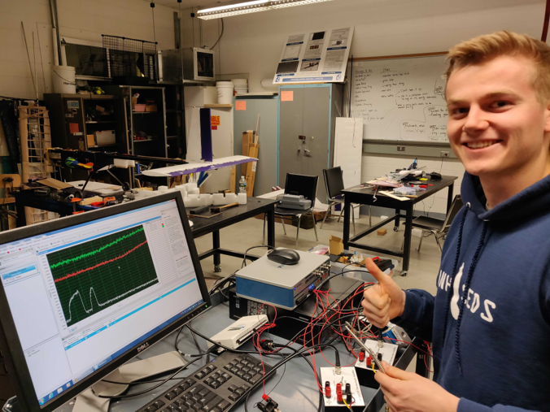
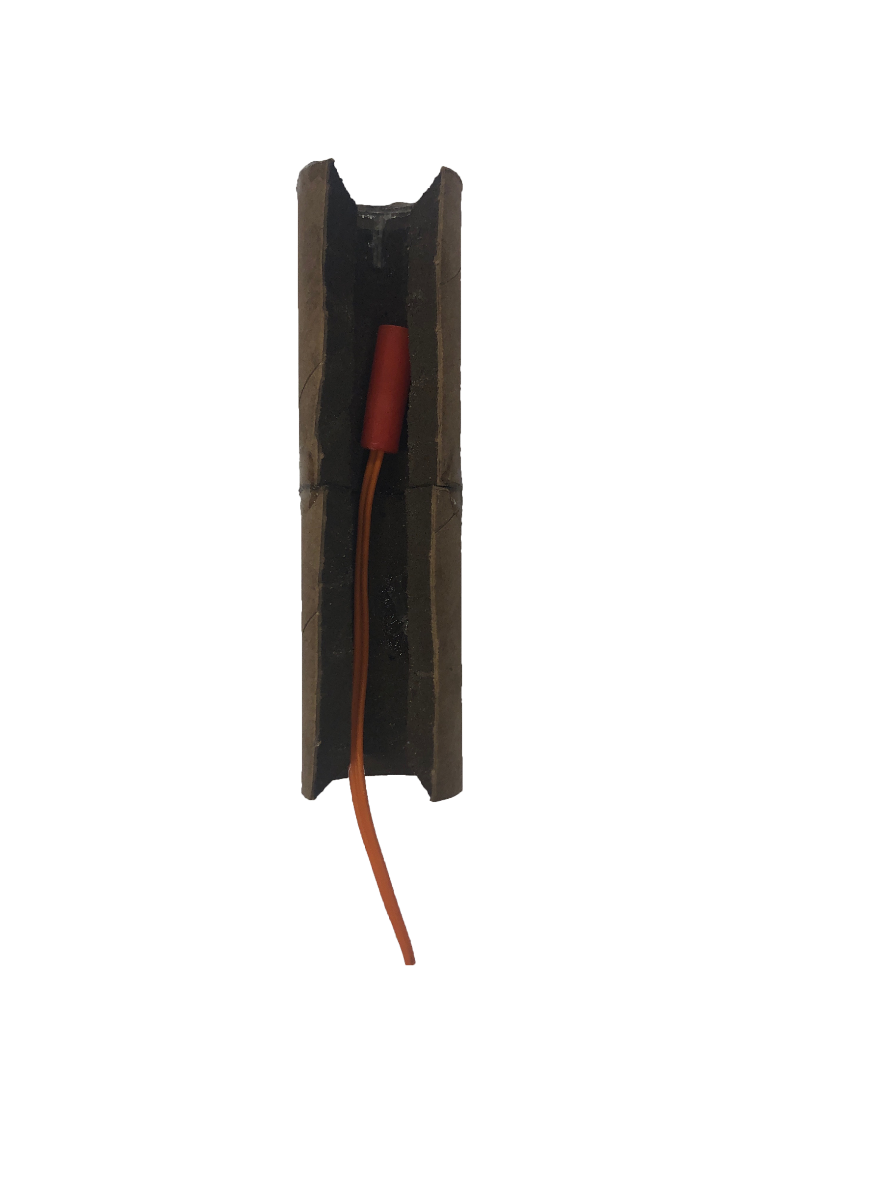

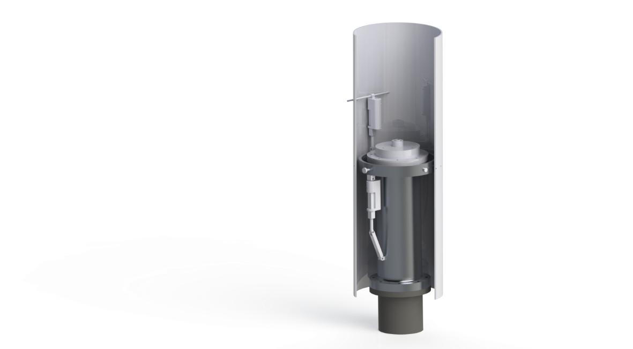
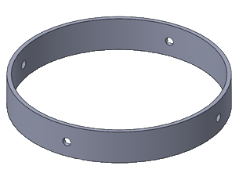
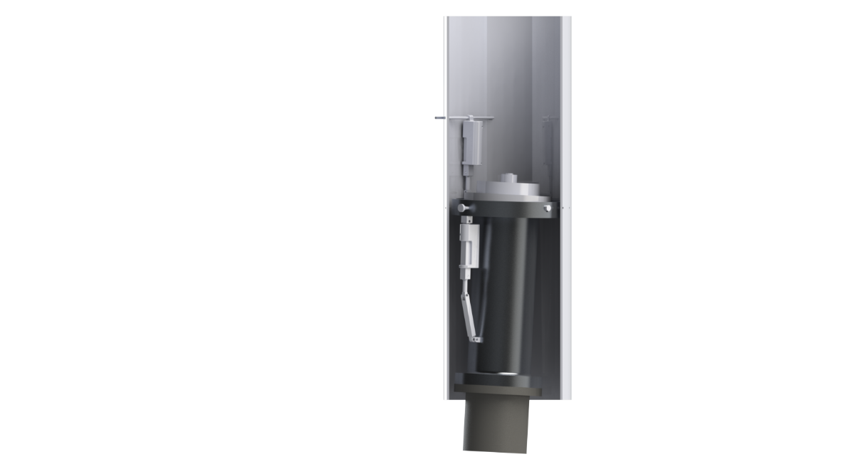
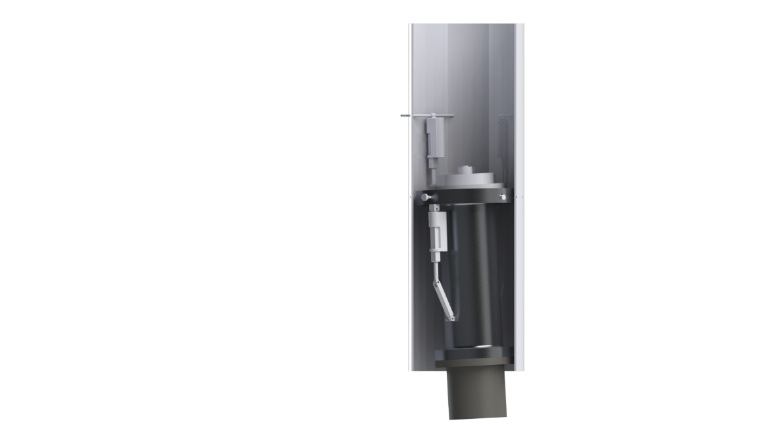
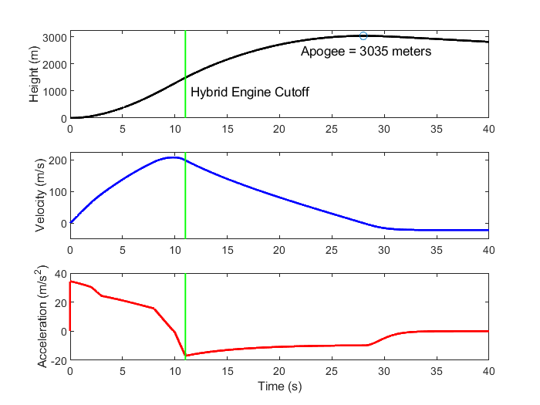
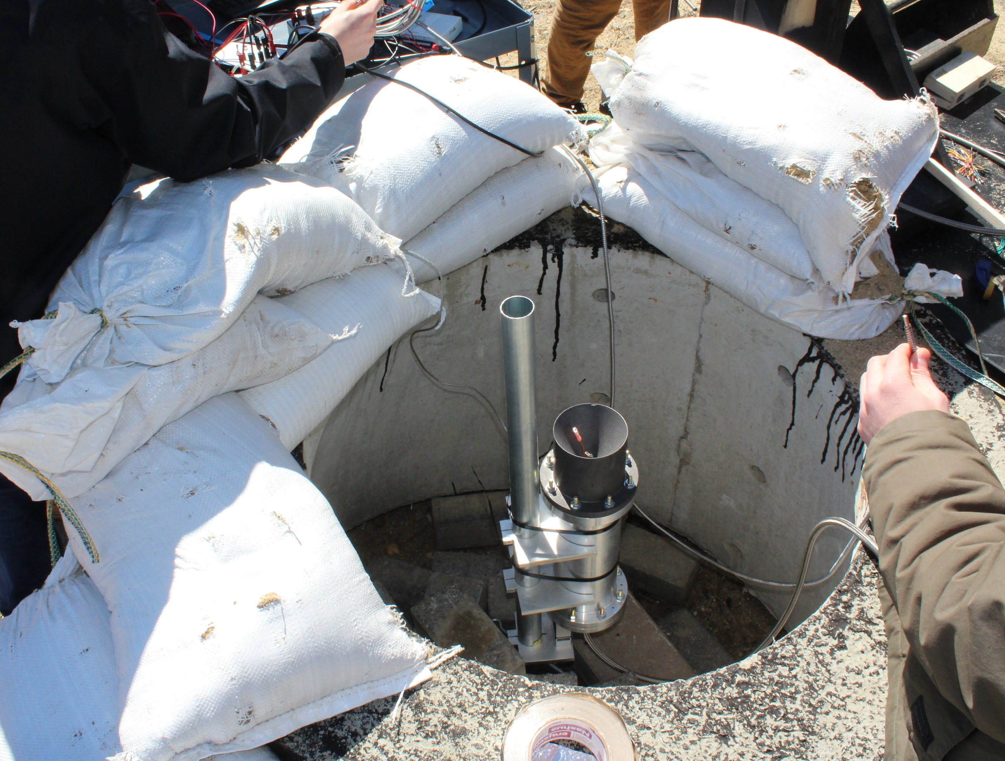
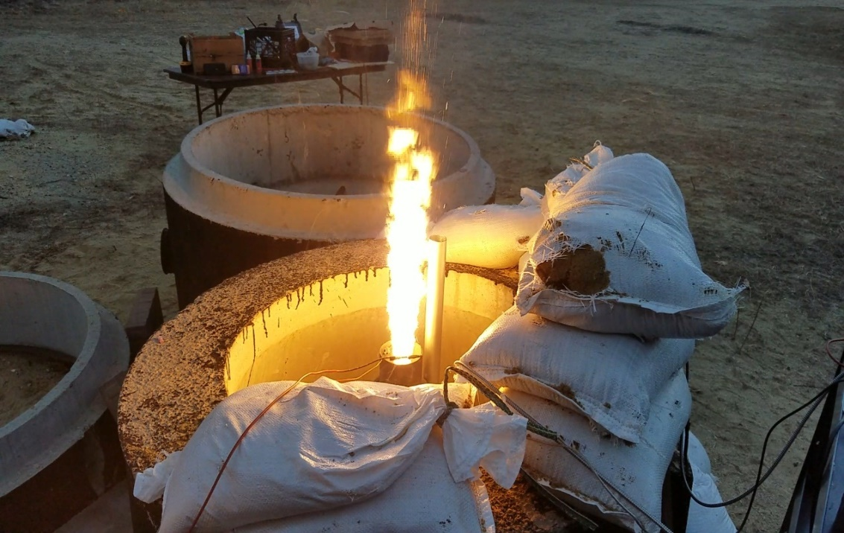
Department of Mechanical Engineering
Authors: Charlie Nitschelm, Andrew Hosman, Collin Stroshine, Ryan Blatti, Chase Eldridge, Tyler Landry, John Langer, Thomas Collins, Silas Johnson
Advisor: Dr. Todd Gross
Who We Are
A second year engineering organization comprised of students of all classes and CEPS majors
A primary engineering goal of pursuing the art of high power rocketry with custom-made hybrid engines
Fuel Selection and Flow Regulation
Oxidizer Tank
A highly pressurized vessel that
contains liquid Nitrous Oxide,
acting as our oxidizer within
the combustion chamber
Hydroxyl-terminated polybutadiene (HTPB) and liquid nitrous oxide were chosen as the reducer and oxidizer, respectively.
A mold was 3-D printed to form the HTPB into a circular grain.
Flow Regulator
A motorized valve that monitors flow regulation
of the oxidizer into the injection plate controlled
by an electric motor and
an Arduino.
The flow regulator controls the amount of flow into the combustion chamber, permitting throttle, cutoff, and reignition
SpaceVision, November 2018
SEDS Rocketry Competition, October 2018
Injection Plate
Responsible for providing desired oxidizer flow into the combustion chamber with the assistance of the impinging plate
The 3 Year Plan
Year One
Year Three
Oxidizer Injection
Hybrid Engine
Design
Manufacture
Test
Various impinging plates were designed to be tested for ideal atomization of the nitrous oxide for maximum efficiency within the combustion chamber
A cold fire test was designed to study overall oxidizer flow characteristics and allow a desired oxidizer flow rate of 1.5 lb/sec to obtain an engine burn time of 10 seconds
Impinging Plate
An interchangeable cylindrical plate responsible for the impingement and atomization of the oxidizer flow streams
Runaway
Rocket Building
Simulating
Launching
Optimizing
Hybrid Rocket
Engine Optimization
Rocket Integration
Competition
Combustion Chamber
An enclosed volume where the solid reducer and liquid oxidizer react to produce a superheated, highly pressurized chamber of gas
Year Two
Combustion and Ignition
Hot Fire Test
Incoming nitrous oxide impinges and atomizes saturating the fuel within the combustion chamber producing vast amounts of hot, dense gases.
A river of hot gases flow through the graphite De Laval nozzle, converting its thermal energy to kinetic energy.
Nozzle
Graphite was machined into a de Laval curve responsible for directing the flow of hot gases outside of the combustion chamber into the environment providing thrust
An igniter device is utilized to produce hot gases within the combustion chamber in preparation for oxidizer flow through the impinging plate.
Test engine to determine thrust produced, mass flow rate, thermal conductivity, and durability of engine.
Load cells and thermocouples used to record desired data.
Thrust Vectoring
Current Work
4 steel pins are used to allow rotation of the hybrid engine while maintaining even distribution of thrust to the entire rocket
Improve flow regulation design by reworking gears
Successfully test hybrid engine and work towards an optimum design
Integrate thrust vectoring system onto the propulsion system
Create accurate launch simulations with real-life data from the hybrid engine and rocket geometry
A gimbal ring is used to provide a second rotational piece that is placed between the engine and the rocket body
Acknowledgments
A huge thanks to all the members of UNH SEDS, Scott Campbell, Dr. Ivo Nedyalkov, Dr. Alireza Ebadi, Sheldon Parent, Andy Globe, Dave Emanuel, Chief Dean, Ronald O’Keefe, TURBOCAM International, Reilly Webb, the UNH Makerspace and our advisor Dr. Todd Gross for all the support
Two actuators positioned 90 degrees apart enable real-time pitch and yaw control

Slide 2
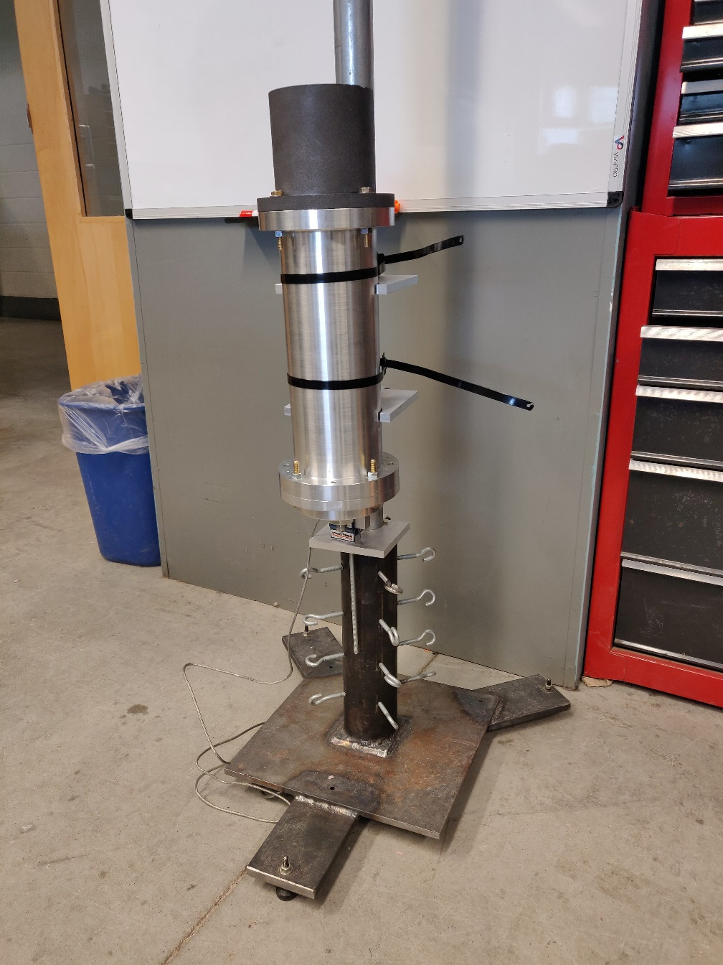
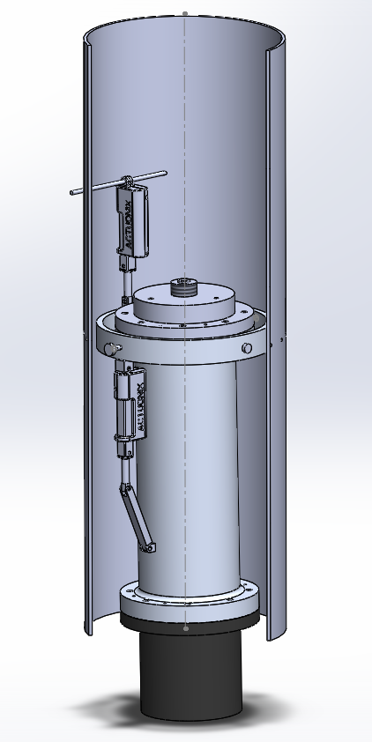
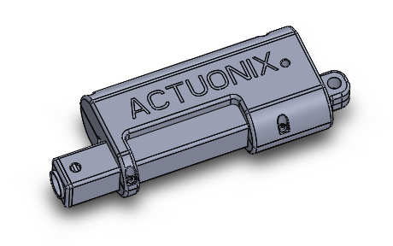
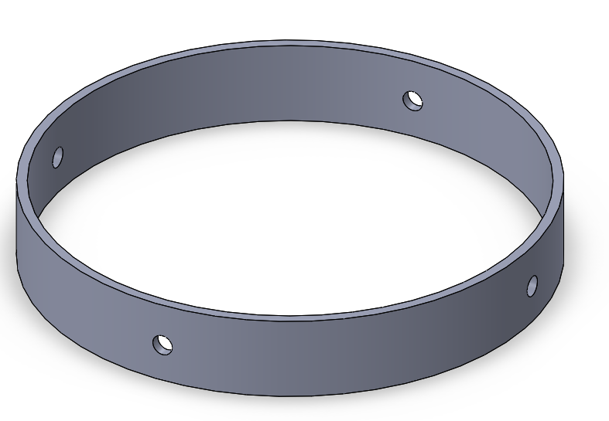
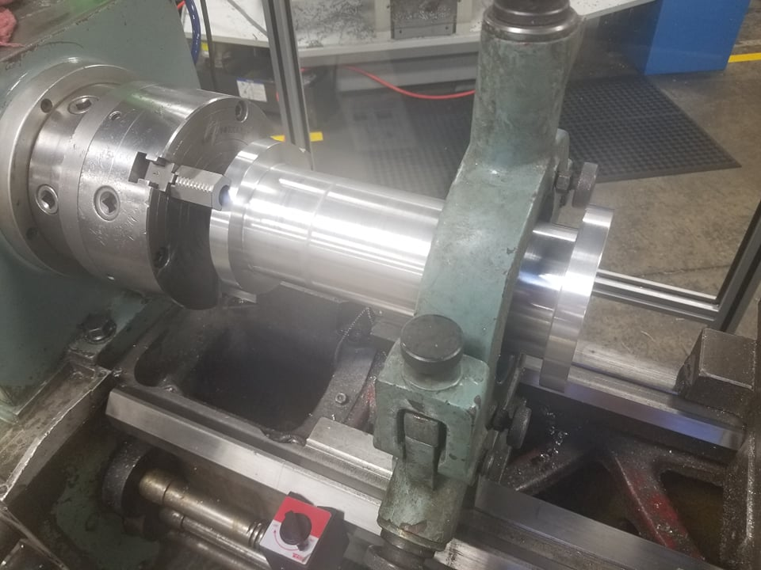

Vertical Static Test Fire Rig
Engine Startup / Ignition Method
Correct ignition method to start-up the engine and provide initial heat and pressure for further combustion with the oxidizer
Obtain an initial injector flow rate
Hot Fire Testing Rig and Data Collection
Used to safely test the hybrid rocket engine in a static rig
Collect precise data on thrust, mass flow rate and combustion temperature for future optimization of the hybrid rocket engine geometry
Gimbal System
Preliminary design work was started last year on commercial off the shelf 29mm engines to assist in the application of those techniques on a larger, homemade hybrid engine
HHHHH
Two actuators will be utilized to control the pitch and yaw of our thrust vector through flight
An accelerometer will be used to sense any variation in our zenith direction, and quickly redirect our engine thrust to return back to the desired flight path
Manufacturing
The combustion chamber and Injector plate were manufactured with the assistance of TURBOCAM International
Both components made of Aluminum 6061 for ease of manufacturing and Tripoli Experimental Rocket Recommendations
Injector plate designed so the plate can be reused, but hole inserts can be redesigned and replaced
The nozzle was manufactured here at UNH by Scott Campbell

